Slide 1
中原大學
資訊工程學系
113學年度專題實驗期末報告
隨機性對於量子糾錯算法的重要性及適用於IBM Quantum的量子糾錯算法
組員
資訊四乙 曾品元11027233
資訊四乙 江庭瑄11027235
資訊四乙 王紫薰11027238

Slide 2
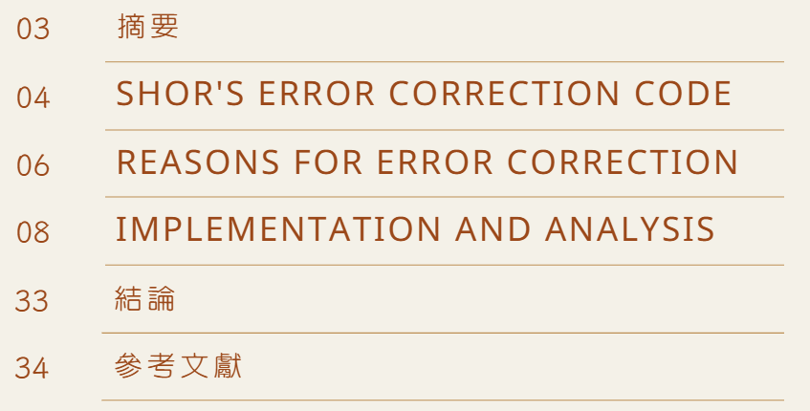
目次

Slide 3
摘要
隨著古典電腦技術的進步，它遇到了瓶頸。von Neumann 架構下，資料儲存技術進步緩慢，古典電腦的運算能力難以大幅提升。相較之下，量子電腦雖然還比較不成熟，但其針對特定問題的時間複雜度卻遠遠超過了經典電腦。然而，迄今為止還沒有一個完美的量子電腦系統，量子位元總是存在錯。因此糾錯變得極具挑戰性，需要一個與傳統完全不同的方法。
在我們的研究中，我們使用模擬器來實現 Shor 糾錯碼（SRCC），並針對位元翻轉錯誤問題開發了隨機方法 Shor 糾錯碼（SRCC-R）。我們考慮錯誤率為 0.007 和 0.002 的 IBM 量子電腦系統。 我們的結果表明，使用 SRCC，翻轉錯誤可以糾正少於 25 個受控非門，正確率為 0.97。在我們的方法中，SRCC-R 的翻轉錯誤可以修正超過 500 個受控非閘，正確率為 0.95。

Slide 4
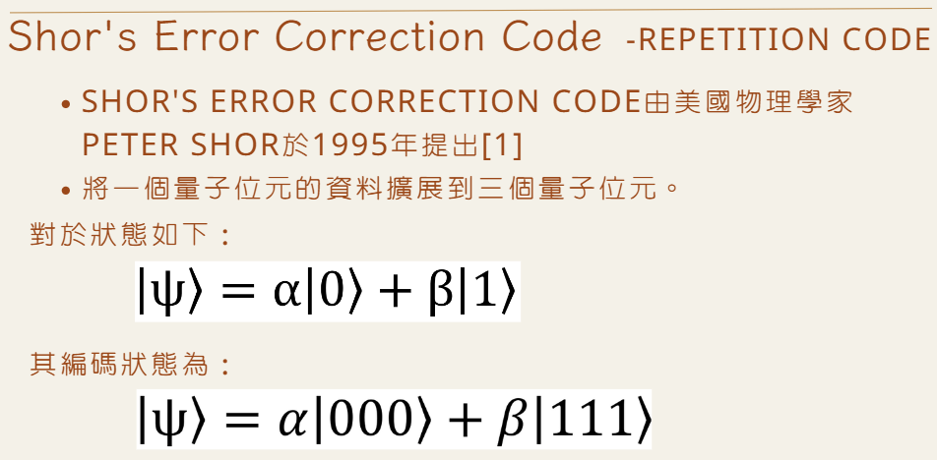

Slide 5
Shor's Error Correction Code
-Repetition Code
每個物理量子位元被編碼成三個量子位元。最終的編碼狀態是9個量子位元，每三個量子位元對應同一個狀態，代表一個初始邏輯量子位元。
Shor's Error Correction Code是量子運算領域的基礎技術之一。它將一個量子位元的資訊分佈到多個量子位元，並利用冗餘來檢測和修正量子計算過程中的常見錯誤。基於此演算法，形成了本文的構思。然而，值得一提的是，1996 年，Steane [2] 發現了 7 個量子位元程式碼中的通用程式碼。 Calderbank 和 Shor [3] 以及 Steane [4] 的論文也展示了量子糾錯的一般理論。

Slide 6
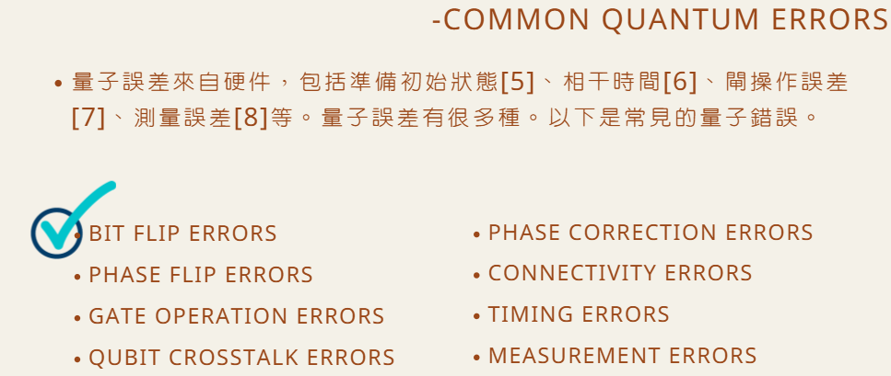
Reasons for Error Correction

Slide 7
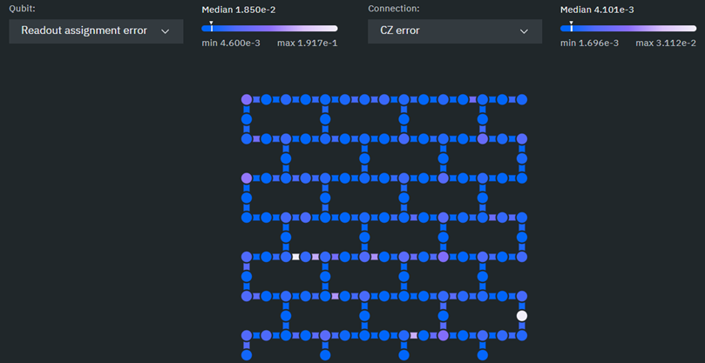
Reasons for Error Correction
-The Arrangement of
the Quantum Computer Qubit Grid
我們選擇IBM Heron r1處理器[9]，如圖所示，並開發了量子糾錯線來對應系統中量子位元的排列。

Slide 8
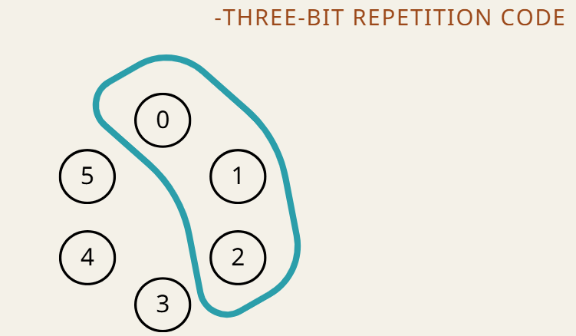
Implementation and Analysis

Slide 9
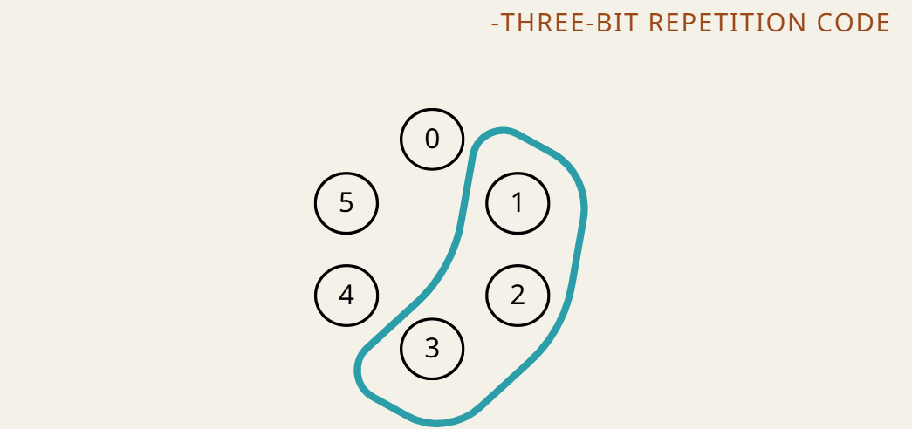
Implementation and Analysis

Slide 10
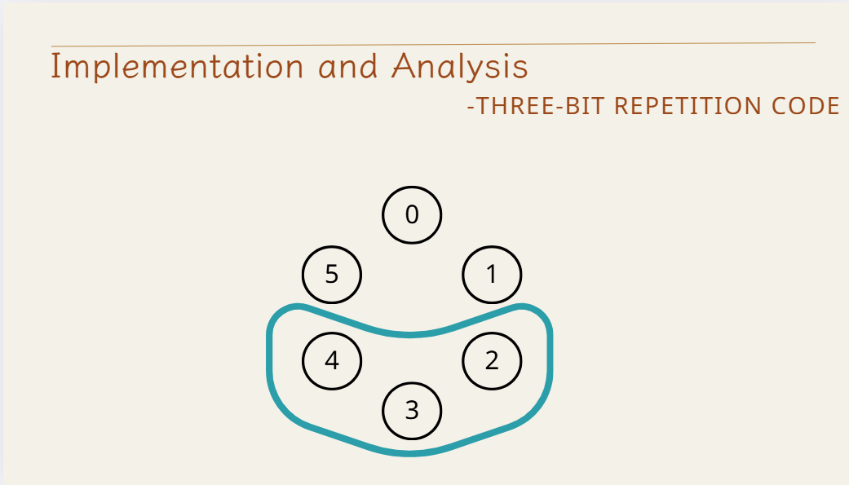

Slide 11
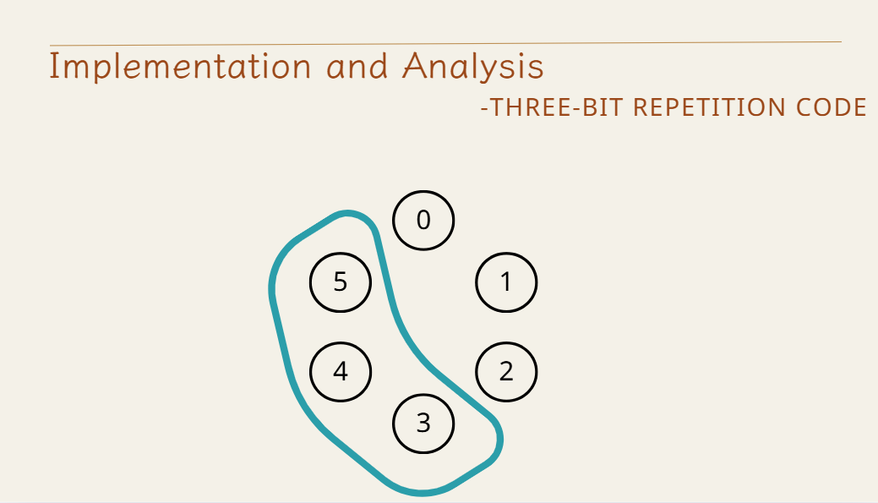

Slide 12
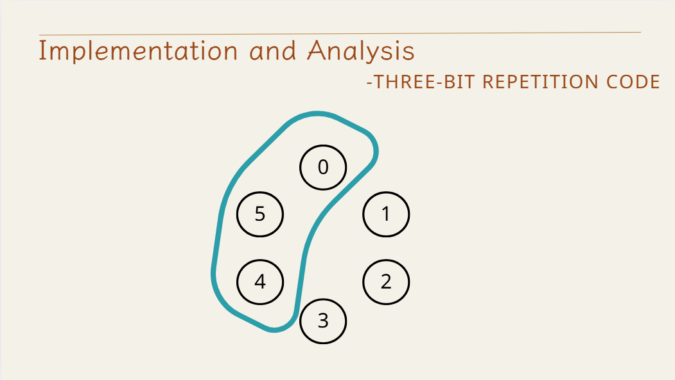

Slide 13
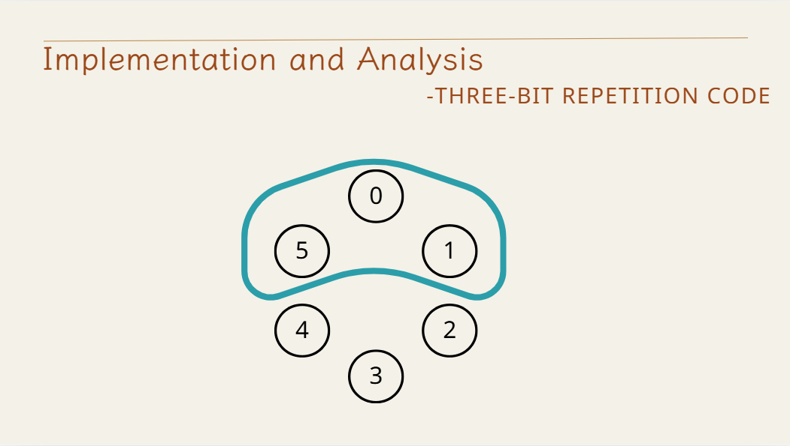

Slide 14
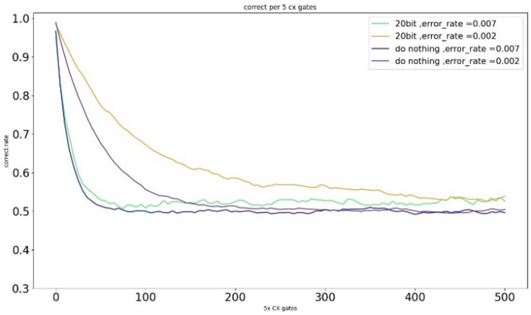
Implementation and Analysis
-Three-Bit Repetition Code
Results of 20-Bit Grouping Error Correction in Circle. Consider the error rate equal to 0.007 and 0,002 in without error correction (dark blue and green) and SRCC error correction (purple and yellow).

Slide 15
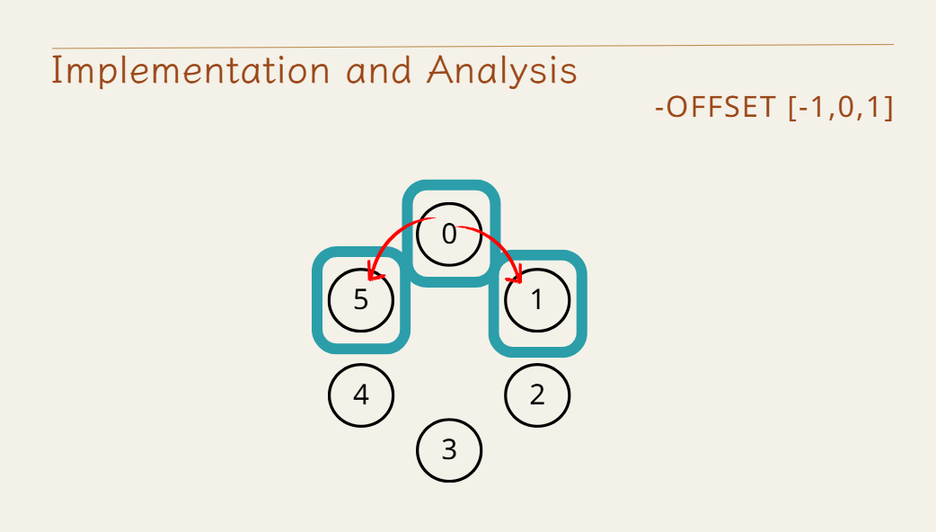

Slide 17
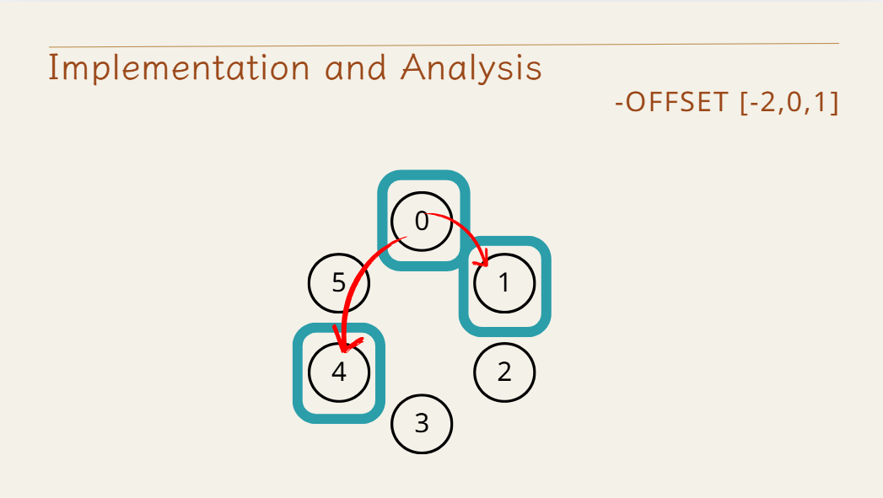
Implementation and Analysis

Slide 18
Implementation and Analysis

Slide 19
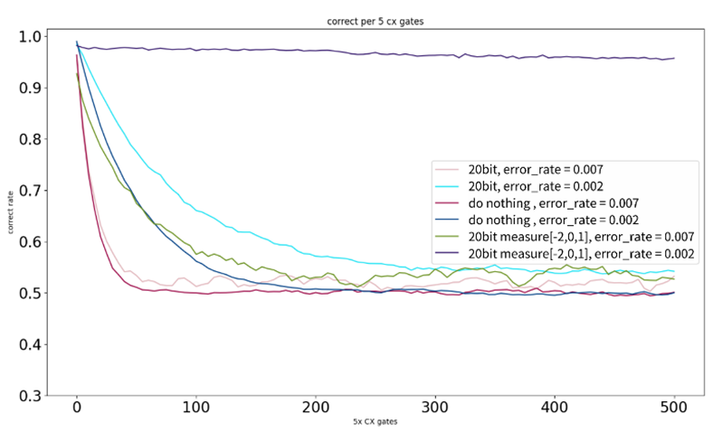
Implementation and Analysis
-offset [-2,0,1]
Results of Sampling according to offset: [-2,0,1]

Slide 20
Implementation and Analysis
-WRITE BACK AFTER ALL BITS ARE FINISHED
1000000001

Slide 21
Implementation and Analysis
-WRITE BACK AFTER ALL BITS ARE FINISHED
1
1100000001

Slide 22
Implementation and Analysis
-WRITE BACK AFTER ALL BITS ARE FINISHED
1
1100000001

Slide 23
Implementation and Analysis
-WRITE BACK AFTER ALL BITS ARE FINISHED
1
1
1110000001

Slide 24
Implementation and Analysis
-WRITE BACK AFTER ALL BITS ARE FINISHED
1
1
1110000001

Slide 25
Implementation and Analysis
-WRITE BACK AFTER ALL BITS ARE FINISHED
1111000001
1
1
1

Slide 26

Implementation and Analysis
-WRITE BACK AFTER ALL BITS ARE FINISHED
1000000001->1111111111

Slide 27
Implementation and Analysis
-WRITE BACK AFTER ALL BITS ARE FINISHED
1000000001
1
1
1

Slide 28
Implementation and Analysis
-WRITE BACK AFTER ALL BITS ARE FINISHED
1000000001
0
0
0
1

Slide 29
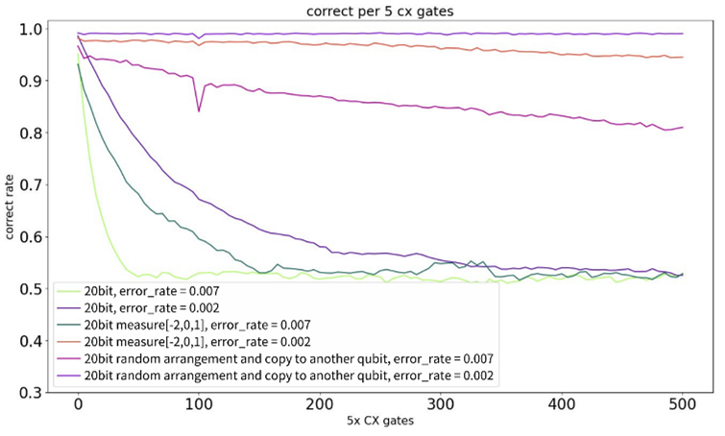
Implementation and Analysis
-WRITE BACK AFTER ALL BITS ARE FINISHED
THE RESULTS OF “WRITE BACK AFTER ALL BITS ARE FINISHED”. IT IS OBVIOUSLY THAT THE CORRECT RATE IS ENHACEND. IT IS SHOULD BE MENTION THAT WE GIVE A HUGE ERROR IN 100TH CONTROLLED-NOT GATES OPERATIONS IN THE SYSTEM. IN OUR METHOD THE CORRECT RATE WILL BE RECOVERED.

Slide 30

Implementation and Analysis
-WRITE BACK AFTER ALL BITS ARE FINISHED
THE RESULTS OF “WRITE BACK AFTER ALL BITS ARE FINISHED”. IT IS OBVIOUSLY THAT THE CORRECT RATE IS ENHACEND. IT IS SHOULD BE MENTION THAT WE GIVE A HUGE ERROR IN 100TH CONTROLLED-NOT GATES OPERATIONS IN THE SYSTEM. IN OUR METHOD THE CORRECT RATE WILL BE RECOVERED.

Slide 31
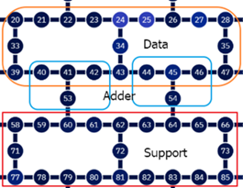
Shuffle Randomly

Slide 32
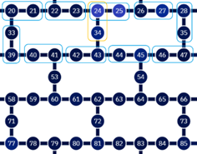
Shuffle Randomly

Slide 33
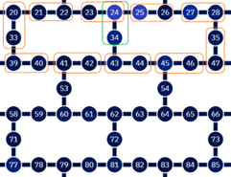
Shuffle Randomly

Slide 34
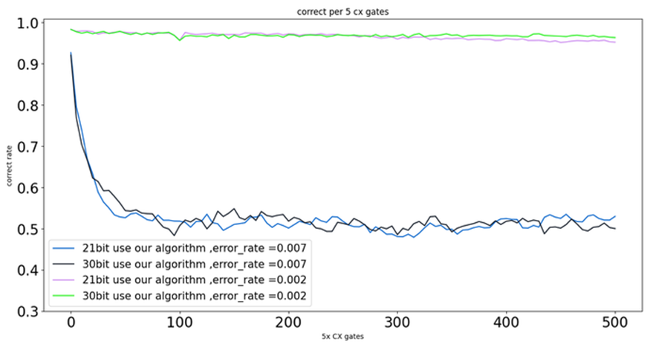
THE RESULTS OF OUR ALGORITHM. WE CAN SEE THAT EVEN MORE THAN 20 BITS SUCH AS 21 BITS AND 30 BITS CAN HAVE A GOOD EFFECT WHEN THE ERROR RATE IS 0.002

Slide 35
結論
總結來說，量子錯誤更正是一個複雜的問題。雖然我們提出的所有方法在錯誤率為 0.007 以下時無法保持穩定的準確率，但如果樂觀地採用 IBM 最新量子電腦的錯誤率（0.002）進行實驗，我們的方法確實可以在某一水準上保持準確率（0.95）。在這個過程中，我們還在特定時間施加了較大的錯誤率，以觀察我們的錯誤更正方法是否能靈活地將準確率恢復至原本的水準。結果顯示非常出色，我們的錯誤更正方法在 IBM 的量子電腦上能保持一定的準確率。此外，我們也理解了隨機排列對所有錯誤更正算法的重要性。在未來開發錯誤更正算法時，應特別關注該方法是否會導致隨機排列的出現。

Slide 36
參考文獻
[1] SHOR P. W., PHYS. REV. A, 52 (1995) R2493-R2496
[2] STEANE A. M., PHYS. REV. LETT., 77 (1996) 793-767.
[3] CALDERBANK A. R. AND SHOR P. W., PHYS. REV. A, 54 (1996) 1098-1105
[4] STEANE A. M., PROC. ROY. SOC. LOND. A, 452 (1996) 2551-2577.
[5] I. H. KIM, NOISE-RESILIENT PREPARATION OF QUANTUM MANY-BODY GROUND STATES, ARXIV:1703.00032 (2017).
[6] AARON SOMOROFF, QUENTIN FICHEUX, RAYMOND A. MENCIA, HAONAN XIONG, ROMAN KUZMIN, AND VLADIMIR E. MANUCHARYAN, PHYS. REV. LETT. 130, 267001
[7] D. WILLSCH, M. NOCON, F. JIN, H. DE RAEDT, AND K. MICHIELSEN, PHYS. REV. A 96. 062306
[8] LENA FUNCKE, TOBIAS HARTUNG, KARL JANSEN, STEFAN KÜHN, PAOLO STORNATI, AND XIAOYANG WANG, PHYS. REV. A 105, 062404
[9] HTTPS://WWW.IBM.COM/QUANTUM

Slide 37
感謝聆聽

